Slide 1
What is Cloud Computing?
What is Cloud Computing? Cloud Computing often referred to as “the cloud”, in simple terms means storing or accessing your data and programs over the internet rather than your own hard drive.
Everything nowadays is moved to the cloud, running in the cloud, accessed from the cloud or may be stored in the cloud.

Slide 2
Where exactly is this cloud?
So to answer this question in this what is cloud computing blog, it is somewhere at the other end of your internet connection where you store your files and can be accessed from anywhere in the world. This could be a big deal for you, primarily because of three reasons:
You do not have to maintain or administer any infrastructure for the same.
It will never run out of capacity, since it is virtually infinite.
You can access your cloud based applications from anywhere, you just need a device which can connect to the internet.

Slide 3
How it all began?
Though internet was born in 1960s, it was only in 1990s when the potential of internet to serve business was discovered, which then led to more innovation in this field. As the transfer speeds of the internet and connectivity got better it gave way to new type of companies called Application Service Providers (ASPs).
ASPs took the existing business applications and ran them for the business using their own machines. The customers would pay a monthly fee to run their business over the internet from ASP’s systems.
But it was only in the late 1990s that the cloud computing as we know it today emerged and led to this blog on what is cloud computing.
And since it has only grown, recently businessinsider reported,

Slide 4
Now that you have a fair idea, what cloud is, just think about all your daily activities online, and you will realize that a lot of your work that you do online is based on cloud. Like your social media interactions are all on the cloud, anything that you store online, is again cloud, you paying your electricity bills online, online shopping, everything!

Slide 5
The way it is used is like this; a field sales representative would need an access to a mobile device which is connected to the internet and then he can retrieve the customer information irrespective of his location. Also, he can update the information on the go therefore no need of going back to the office to update the deal information.
The sales managers can also monitor everything on their internet enabled devices, and will know which deals to close or not. It all happens on the go!
The best part? You don’t have to buy any machines or administer any kind of software, it all will be handled by the cloud company which is running this application. Cool right?

Slide 6
Now when you ask what is Cloud Computing the answer would be in a very broad sense therefore, the services it offers has been divided into three different models, let’s discuss each one of them:
SaaS
PaaS
IaaS

Slide 7
SaaS(Software As a Service)
In this service the Cloud Provider leases applications or softwares which are owned by them to its client. The client can access these softwares on any device which is connected to the Internet using tools such as a web browser, an app etc.
For Example: salesforce.com provides the CRM(Customer Relation Manager) on a cloud infrastructure to its client and charges them for it, but the software is owned by the salesforce company only.

Slide 8
PaaS(Platform as a Service)
In this service the Cloud Provider gives the ability to the customer to deploy customer created application using programming languages, tools etc that are provided by the Cloud Provider. The customer cannot control the underlying architecture including operating systems, storage, servers etc.
For Example: This service would make sense to you only if you are a developer, since this service provides you a platform for developing applications, like Google App Engine.

Slide 9
IaaS(Infrastructure as a Service)
In this service the Cloud Provider provides the customer with virtual machines and other resources as a service, they abstract the user from the physical machine, location, data partitioning etc. If the user wants a Linux machine, he gets a linux machine, he will not worry about the physical machine or the networking of the system on which the OS is installed, simple.

Slide 10
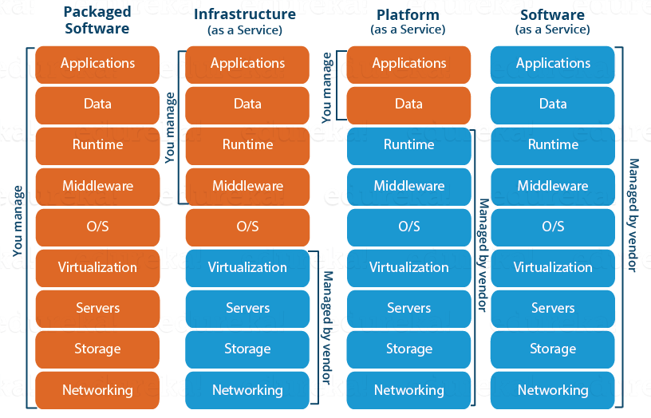

Slide 11
We now know about the service models, once you offer a service next comes deployment, let us now discuss the deployment models:
Public Cloud
Private Cloud
Hybrid Cloud

Slide 12
Public Cloud
In a public cloud deployment mode, the services which are deployed are open for public use and generally public cloud services are free. Technically there maybe no difference between a public cloud and a private cloud, but the security parameters are very different, since the public cloud is accessible by anyone there is a more risk factor involved with the same.

Slide 13
Private Cloud
A private cloud is operated solely for a single organization, it can be done by the same organization or a third-party organization. But usually the costs are high when you are using your own cloud since the hardware would be updated periodically, security also has to be kept in check since new threats come up every day.

Slide 14
Hybrid Cloud
A hybrid cloud consists the functionalities of both private and public cloud. How?
Let’s understand it through an example: Suppose there is a research company, so they would have some published data and also, data which would still be in research phase. Now any thing which is still in research should be kept confidential right? Though your cloud provider may have state of the art security features but then it is still open to public, therefore prone to cyber attacks.
So to address this risk, you can keep the data still being worked on, in your company’s servers whose access is controlled by the company, and your published data on the public platform, this type of arrangement would be a hybrid cloud.
I think by now you must have a fair idea about what is cloud computing. Let’s go ahead and know the target audience of the cloud, that is YOU, now you can either be looking at the cloud as an individual or a business, let’s take an insight into both the perspectives.

Slide 15
Consumers v/s Business
Let’s talk about consumers here, those of us who work in small to medium offices, use internet on a regular basis, for us cloud would be say Google Drive or maybe DropBox.
But, for organisations and businesses, it is an entirely different scene, for them cloud is SaaS where they might want to use a software on the cloud, or maybe PaaS where they might want to build an app on an environment which is provided by the cloud environment or maybe they want to avail the cloud service as an Infrastructure where in they will rent out entire VMs and configure it their own way, which will be IaaS.
Now you maybe wondering, do companies really use Cloud Computing? Of Course they do, according to a popular blogging site PCMag cloud computing generated 127 billion dollars in 2016, and by 2020 it could be 500 billion dollars.
Pretty impressive ain’t it? Now why are people or businesses moving to cloud? There should be some advantages right?

Slide 16
Let’s go ahead and see what advantages does Cloud Computing serve:
Fast Implementation If you’ve been there for a development or implementation of an application, it takes sometimes months or even years to make the application up and running, with cloud you can cut through the time and make things faster.
Instant Scalability With cloud resources you can always scale up or scale down the no. of resources and users according to your need, the cloud capacity never runs out!
Access Anywhere Applications built on cloud are designed to be accessed from anywhere, you just need an internet connection on a mobile device.
No Upfront Costs Earlier to deploy an application you had to purchase the necessary hardware, build the architecture, purchase software licenses etc, but with cloud all those costs are dramatically reduced and in some cases eliminated.
Maintenance Free Traditionally you would have to patch your software with the latest releases, upgrade your hardware and also troubleshoot faults in your system at the hardware level, but with cloud you don’t have to worry about the maintenance of your hardware, it will all be managed by your cloud provider.
Better Security An Independent study found that yearly a medium scale company loses around 260 laptops, this is a loss to the company not in monetary terms, but the data that was there on the laptop is valuable, with Cloud you don’t have to worry about that, all your data is stored in a centralized secure location.

Slide 17
Now, how do you get started?
There are tons of cloud providers out there to choose from. Let us take the most prominent ones.
Azure: It’s a cloud computing platform by Microsoft founded in 2010.
AWS: Amazon Web Services is a cloud computing platform by Amazon in 2006.

Slide 18
What are Virtual Machines
Until Virtual Machines came into existence, we had a one-to-one mapping between a business application and the physical server upon which it is installed. For example, if there are 3 production apps, 3 physical servers are required. Everytime a new application is required, businesses had to procure a new physical server. There is only one production app running on the server and in most cases, I mean 9 out of 10, the app only use a fraction of the server capacity, may be 5 to 10 percent. What a waste of company money and you can see, how quickly this can become unwieldy and very expensive for the organisations.

Slide 19
What are Virtual Machines
With virtualization, we are able to squeeze much more from physical servers. This is a bit over-simplified, but the model worked something like the following.

Slide 20
On top of the physical server, we have the operating system installed. This is the host operating system i.e operating system at the physical server level. On top of that we install a piece of software called Hypervisor. Hypervisor is a technology from VMware that virtualises the hardware of the physical server. On top of this we create a virtual machine. In fact, we can create and run multiple virtual machines on a single physical server. My first application runs on VM1 and the second application runs on VM2. If I have a thrid application, I simply spin up a new VM and then safely and securely run it from the third VM. This is brilliant, because we are now able to make proper use of the server hardware.
There is no longer a one to one mapping between a business application and a physical server. Thanks to virtualization, we can now safely isolate and run more than one application from a given physical server. So everytime, we need a new application for the business, it is no longer the case where we have to procure a new physical server. With virtualization, we are able to safely and securely run multiple apps on a single physical server.

Slide 21
Because of this virtualization, each application thinks that it is running on a dedicated physical server with it's own dedicated processer, memory, drive space etc, while in reality they are running on the same physical server but on a dedicated virtual machine. You can think of a virtual machine as a computer within a computer. Multiple virtual machines can run simultaneously on the same physical server. In each virtual machine, we can install an operating system of our choice (windows, linux etc), typically we install the operating system and dependencies our production app requires.
Virtual machines are great. They allow us to run more than one app on a given physical server, which obviously promotes better use of server hardware. However, with each virtual machine that is created there is a lot of overhead. We will discuss what this overhead is and how containers are set out to solve this problem in our next video.

Slide 22
Virtual Machines and Multiple applications
Let's say we have 4 applications - App 1, App 2, App 3, and App 4. We want to be able to run all these 4 apps on one physical server - Server 1. Obviously, we cannot run applications directly on the server hardware. We need an operating system like windows or linux. This is the Host OS i.e the operating system at the server level. On top this we install a piece of software called Hypervisor. It is the Hypervisor, that creates and manages virtual machines. We have 4 apps that we want to run in isolation on this physical server, so we create 4 virtual machines.
how can we run multiple applications on virtual machines simultaneously

Slide 23
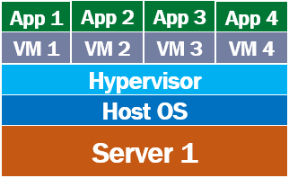

Slide 24
a virtual machine virtualises the hardware of the physical server. This means each virtual machine that is created, gets a slice of the the server hardware. In our case we created 4 virtual machines, so each VM gets 25% of memory, disk space, processor and other server hardware resources.

Slide 25
What are containers and how are they different from virtual machines
we discussed what are virtual machines and how they allow us to run multiple applications on a single physical server. However, with each virtual machine that we create, there is a lot of overhead, both in terms of cost and maintainability. Let's understand this with an example.

Slide 26
Virtual Machines and Multiple applications
Let's say we have 4 applications - App 1, App 2, App 3, and App 4. We want to be able to run all these 4 apps on one physical server - Server 1. Obviously, we cannot run applications directly on the server hardware. We need an operating system like windows or linux. This is the Host OS i.e the operating system at the server level. On top this we install a piece of software called Hypervisor. It is the Hypervisor, that creates and manages virtual machines. We have 4 apps that we want to run in isolation on this physical server, so we create 4 virtual machines.
how can we run multiple applications on virtual machines simultaneously
As we discussed in our previous video, a virtual machine virtualises the hardware of the physical server. This means each virtual machine that is created, gets a slice of the the server hardware. In our case we created 4 virtual machines, so each VM gets 25% of memory, disk space, processor and other server hardware resources.

Slide 27
What are containers
A virtual machine virtualises the server hardware where as containers virtualises the operating system, i.e it's an abstraction at the operating system level. Multiple containers can run on the same machine and share the host operating system kernel. Unlike a VM, a container does not required it's own operating system. Straight away you can see the amount of disk space, ram and processor time that is saved.
containers vs virtual machines
Each conatiner packages your application code and it's dependencies together. If you have 3 apps to run on a single physical server, you create 3 containers. Each application thinks, it is running on a dedicated OS and a dedicated server hardware. In reality all the container apps are sharing the same host operating system and hardware.
In case of VMs, admin time is required to install security patches and keep up to date host operating system and the guest operating systems on all the VMs. No matter how many containers we have on our server, there is just one host operating system that demands admin time.

Slide 28
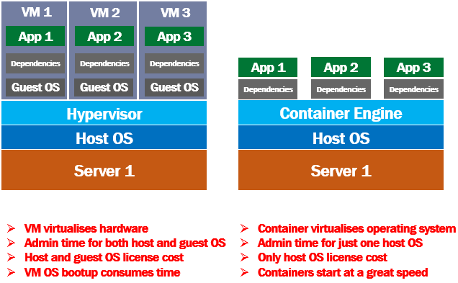

Slide 29
From the cost standpoint, in case of VMs, we have to pay for host and the guest operating systems of all the VMS, where as in case of containers, we have to pay just for the 1 host operating system.
A container is very small compared to a VM. Since a container does not have it's own operating system to bootup, it can usually be brought online in a very less time compared to booting up and entire VM and it's operating system.

Slide 30
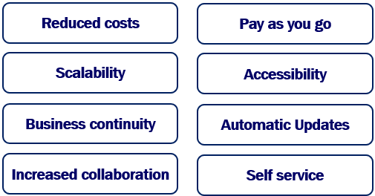
Benefits of cloud computing
These days cloud is everywhere. So in this video, we will understand why cloud? What are the benefits or advantages it offers.
benefits of cloud computing

Slide 31
Pay as you go
With cloud, it's pay-as-you-go, meaning, you only pay for what you use. It's like your utility bills, electricity or water bill. If there is lot of demand for your application and you use lot of cloud resources like storage, computing power etc, you pay more. You use them less, you pay less. So, the bottom line is, cloud resources are metered and you only pay for what you use.
Scalability
Cloud provides lot of scalability and flexibility options. May be you are launching a new business or product line and you need more cloud resources. You can scale up cloud resources like memory, processing power, storage etc, with just a click of a button. You can even automate this by setting threshold limits. For example, if 90% of the existing storage capacity is reached, add another 100 GB to the storage. You can do the opposite as well. If you are not using the resources, you can scale them down. Again, even for scaling down, you can set threshold limits and automate. With cloud, we will never run out of resources. When you need more power, scale up and when you don't, scale down. You no longer, have the burden of purchasing and installing that expensive upgrades yourself. Your cloud service provider like Azure or Amazon web services, handles this for you.

Slide 32
Accessibility
Cloud-based applications, services and data can be accessed from virtually anywhere and anytime. Home, office, while on holiday or in commute. All you really need is an internet-connected device.
Business Continuity
If you have your data stored on your own on-premise server, and, if there's a hardware failure, power failure or other crisis, your data is gone. Without data it is extremely difficult to run the business. The fact is, no data no business. On the other hand if you have data stored in the cloud, hardware failure, power failure, natural disaster or other crisis do not result in data loss because of networked backups.
Automatic Updates
If you have your services and applications on-premise, you are responsible for downloading, and installing software updates and security patches which is not only tedious but also time consuming. On the other hand, if you are using cloud, security patches and updates are installed automatically, off-sight by the service provider. You just to have to pay a small monthly fee. You don't have to worry about rolling out those updates and patches. Instead you can use that time to focus on what matters to the business.
Increased collaboration
With cloud it's very easy for teams and team members to access, edit and share files anytime and from anywhere. There is no longer the need to send documents and spreadsheets in email. It's all in the cloud and everyone who want to have access has access. So teams are able to better collaborate and work together.

Slide 33
Most of the resources and services cloud provide can be self serviced, meaning with a little bit of learning curve most people can easily procure, configure and use cloud resources and services. For example, if you need a server to host your business application, there is no need to consult IT experts to determine how big and fast the server has to be. With just a few clicks you can very easily procure a virtual machine from the cloud and host your application. If you need more processing power, you scale up and you don't need as much, you scale down, again with a few simple clicks. You will see how easy it is to create VMs,

Slide 34
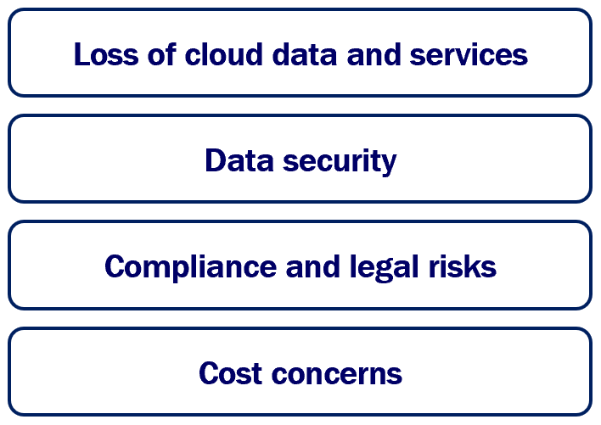

Slide 35
What is a public cloud. Benefits, limitations and use cases
There are different types of clouds.
Public cloud
Private cloud
Hybrid cloud
In this article we will understand, what is a public cloud, benefits, limitations and use cases. In our next articles we will learn about Private and Hybrid cloud.
What is a public cloud
As the name implies, a public cloud is public and is the most common type of cloud. It is easy for anyone i.e an individual or an organisation to start using public cloud resources and services. There is no upfront huge capital expenditure. You don't have to buy the expensive hardware or worry about set up and maintaining the cloud. This is because, with the public cloud, all the infrastructure (i.e the physical servers, storage, networking etc) are procured and owned by the cloud service provider. It is this cloud service provider, that sets up the cloud and maintains it there on. Microsoft Azure and Amazon Web Services are examples of a public cloud.

Slide 36
We access public cloud resources and services over the internet. So to use a public cloud, we need an internet connection and manage the cloud services and resources through a web portal provided by the cloud service provider. For the cloud services and resources we use, we pay a monthly fee to the public cloud service provider. This monthly fee is like your utility bills, water or electricity for example. It's pay as you go model, meaning you pay for what you use.
Anyone can use the public cloud. In a public cloud, your organisation share the same hardware, storage and network devices with other organisations. In cloud computing terms, this is called multi-tenancy. Your organisation data may be stored along with other organisations data on the same storage device.

Slide 37
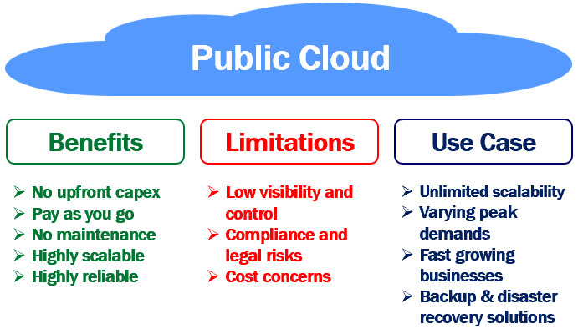

Slide 38
Benefits of public cloud
You don't have to buy expensive hardware or set up your own datacenter i.e no upfront capital expenditure.
It supports pay as you go model. You only pay for what you use, just like your water, or electricity monthly bills.
No maintenance headaches. You as a consumer, don't have to worry about maintaining the public cloud i.e replacing the failed hardware, installing the security patches, updates etc. Your service provider is responsible for maintaining the public cloud. You only pay a small monthly fee, based on the cloud services you use.
Highly scalable. You will almost never run out of resources in a public cloud. Based on your business needs you can scale resources up and down. You can even automate this by setting threshold limits.
Highly reliable. A public clous is a vast network of servers. So data, is always backed up. This means hardware failure, power failure, natural disaster or other crisis do not result in data loss. So, bottom line, public cloud is highly reliable.

Slide 39
Limitations of public cloud
Low visibility and control - Public cloud infrastructure is owned by the cloud service provider. You don't have much visibility and control over it.
Compliance and legal risks - Since you don't have much visibility and control over public cloud infrastructure, you are relying on the cloud service provider to protect data and adhere to local and international regulations. Your company may still be liable, if the cloud service provider, fails to live up to the task and if there is a data breach. So a public cloud, may not be the most viable solution for security sensitive or mission-critical applications.
Cost concerns - Cloud in general, reduces upfront infrastructure costs and it's pay-as-you-go model provides more flexibility. Depending on the traffic, the amount of cloud resources you consume, the plan you have chosen, the way you scale resources up and down, determines the overall price you pay. Sometimes this overall price tag may be higher than what you anticipated.

Slide 40
When to use public cloud
We never run out of resources in a public cloud. It provides near-unlimited scalability. So, if you want to dynamically scale up and down at will, then public cloud is your solution.
Businesses with varying peak demands greatly benefit from the public cloud. When there is high demand you scale up and when the demand subsides, you scale down and pay only for what you use.
Fast growing businesses also greatly benefit from the public cloud. They can use the public cloud and quickly scale up operations rather than having to build your own private cloud which not only has huge upfront capital expenditure but also time consuming.
Businesses can also benefit from the public cloud by using it for backup and disaster recovery solutions.

Slide 41
What is a private cloud. Benefits, limitations and use cases
In this article we will understand, what is a private cloud, benefits, limitations and use cases. In our next articles we will learn about Hybrid cloud.
What is a private cloud
As the name implies, a private cloud is private to one organisation. In other words, a private cloud resources and services are used exclusively by one business or organisation. Unlike public cloud, a private cloud resources are not shared by multiple organisations. All the hardware infrastructure and software are solely dedicated to one organisation.

Slide 42
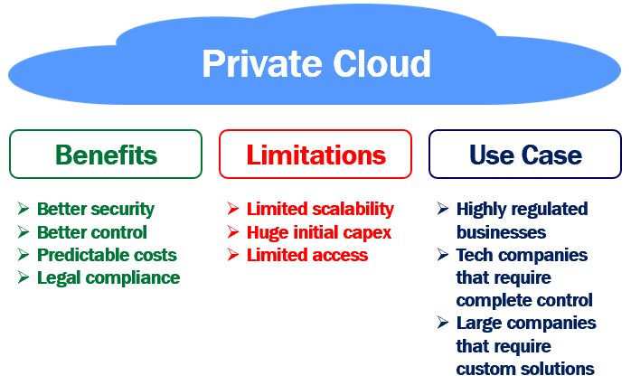

Slide 43
The private cloud is physically located on-premise i.e at your organisation’s on-site data centre, or it can also be hosted by a third-party service provider. The important point to keep in mind is, a private cloud is private, i.e all the hardware infrastructure and software are solely dedicated to one and only one organisation.
In a private cloud, it's very easy to customise the hardware and software to meet your oragnisation's specific IT requirements. This is because your organisation, owns everything i.e the hardware, software and network. So you have complete control and can change anything in any way you want to meet your organisation requirements.
In general, private clouds are often used by government agencies, financial institutions and any other medium to large-sized organisations with business-critical operations seeking enhanced control over their environment.
Benefits of private cloud
Better security - Resources are not shared with other organisations, so there is better security with private cloud.
Better control - A private cloud belongs to a specific organisation, so you can customise it to meet your specific business needs.
Predictable costs - With private cloud you own all the cloud infrastructure and you are not paying any third party cloud service provider. So your monthly cooling, energy and maintenance costs are usually predictable.
Legal compliance - When you deal with regulated data, for example, financial, health care or credit card data, there are strict rules around where the data is stored, who can handle and process it and how it is protected. With the private cloud you know where you data center is located. So you know where the data is stored and how it is protected.

Slide 44
Limitations of private cloud
Limited scalability - The extent to which you can scale up in a private cloud is limited by the amount of infrastructure you have. Beyond certain point, you cannot scale up. So, the infrastructure is a limiting factor and you may not be able to scale up at will like in the public cloud, to meet unpredictable demands.
Huge initial capital expenditure - With the private cloud you have to procure all the cloud infrastructure. Hire the workforce to set up and maintain the cloud. So a private cloud, is an expensive solution compared to public cloud alternatives especially for short-term projects.
Limited access - A private cloud is usually more secure. We use it for security sensitive applications. Because of these high security measures in place, mobile users may have limited access to the private cloud outside of the corporate network.

Slide 45
What is a hybrid cloud. Benefits, limitations and use cases
As the name implies, a hybrid cloud is hybrid i.e, it's a combination of both the private cloud and the public cloud. It is not a different cloud altogether. It's just that, both, the private and public clouds work together to meet our organization requirements. I mean, it offers the best of both the worlds.
For example, we can use the private cloud for security sensitive, business-critical operations like financial reporting, and, the public cloud for high-volume, lower-security needs such as web-based email.

Slide 46
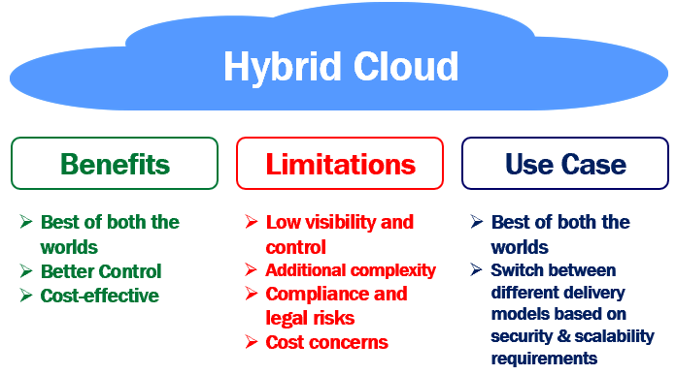

Slide 47
In a hybrid cloud, we have a concept called cloud bursting. This sounds like a fancy technical term, but all it means is the following. You have an application or a service. To start with, it's hosted and running in your private cloud. The application continues to run in your private cloud until there is a spike in the demand. When there is a spike in demand, "burst through" to the public cloud to tap into the additional computing resources provided by the public cloud. When the spike in demand subsides, you scale down just to your private cloud and no longer use the public cloud resources.
If you are wondering, why will there be a sudden spike in demand. Well, there are number of reasons. May be you are launching a new business or product line. Seasonal events like online christmas shopping or tax filing for example, may aslo increase the traffic to your application or service.
With private cloud you only have so much physical infrastructure. How much you can scale up, depends on that physical infrastructure. Beyond certain point, if you want to scale up, you have to buy additional hardware, which is not only expensive but also time consuming to procure and setup. When the spike in demand subsides, we are no longer using this additional infrastructure.

Slide 48
Benefits of hybrid cloud
Best of both the worlds - The obvious benefit is, a hybrid cloud provides, best of both the worlds ie. private and public clouds.
Better Control - With the hybrid cloud, you have better control on what runs where. For example, you can use the private cloud for security sensitive apps and the public cloud for thos apps that have high-volumes of traffic, but not that security sensitive.
Cost-effective – With the hybrid cloud, you only use public cloud resources when you need them i.e when there is a spike in demand, you burst through to the public cloud to use that additional computing power provided by the public cloud. When the demand subsides you scale down just to your private cloud.
Limitations of hybrid cloud
Low visibility and control - Just like a public cloud, even in a hybrid cloud, you don't have much visibility and control over infrastructure that is owned by the public cloud service provider.
Additional complexity - Integrating private cloud with public cloud introduces additional infrastructure complexity. Also, it invloves, considerable effort, time and complexity to maintain and evolve these 2 different types of clouds as the organization needs change.
Compliance and legal risks - Since you don't have much visibility and control over public cloud infrastructure, you are relying on the cloud service provider to protect data and adhere to local and international regulations. Your company may still be liable, if the cloud service provider, fails to live up to the task and if there is a data breach.
Cost concerns - If you use the public cloud resources for a along time, the overall price tag may be higher than what you anticipated.
When to use hybrid cloud

Slide 49
Hybrid cloud provides, best of both the worlds - i.e private and public clouds. For example, you are an IT company and provide services to 2 different sets of clients. For, one set of clients, security is not a massive concern. They just want to scale up and down at will. For these clients you can use the public cloud resources. For the other set of clients, security is the most important thing and they want to have complete and rigorous control over the cloud infrastructure. For these clients, you can use the private cloud resources. So the point that I am trying to make is, a hybrid cloud allows you to switch between different delivery models depending on your clients security and scalability requirements.

Slide 50
Private vs Public vs Hybrid cloud
There are different types of clouds.
Private cloud
Public cloud
Hybrid cloud
We discussed what these 3 clouds are, benefits, limitations and use cases in our previous 3 articles. In this article, we will compare and contrast them side by side.

Slide 51
Private Cloud | Public Cloud | Hybrid Cloud
Cloud Hardware | The entire cloud infrastructure (i.e the physical servers, storage, networking etc) must be procured by the organisation that owns the private cloud | The public cloud service provider like Amazon or Microsoft provides the infrastructure | For the private cloud, your organisation must provide the infrastructure where as the public cloud service provider provides the infrastructure for the public cloud
Tenancy | Single-tenancy. A private cloud is usually used by a single organisation. | Multi-tenancy: A public cloud is used by multiple organizations. | The private part of the hybrid cloud is used by a single organisation. The public part of the hybrid cloud is used by multiple organisations.
Data Center Location | Inside the organization’s corporate network. | Anywhere on the Internet. Public cloud (like AWS and Azure) data centers for example, are typically located in many countries across the entire world. | The private cloud data center is typically inside the organisation's corporate network and the public cloud data center could be anywhere on the internet.
Scalability | Private cloud scalability is limited by the amount of infrastructure. Beyond certain point it is impossible to scale up, unless the organisation procures additional hardware and set it up. | We never run out of resources in a public cloud. It provides near-unlimited scalability. | The scalability of the private cloud services and resources is limited by the underlying available infrastructure, where as with the public cloud services we do not have such a limitation.
Cloud Maintenance | The organization itself is responsible for setting up and maintaining the private cloud. | The cloud service provider is responsible for setting up and maintaining the public cloud. Organizations and even general public can use the public cloud services by paying a monthly fee. | The private cloud is managed by the organization that owns it where as the public cloud is managed by the cloud service provider.
Costs | Invloves huge initial capital expenditure as the organization must purchase all the cloud hardware, set it up and maintain there on. To maintain the private cloud, the organization needs to hire work force. So there is monthly operating expenditure as well. | With the public cloud there is no initial capital expenditure, but you pay a monthly fee for the public cloud services you use. The more you use the services, the more you have to pay. The overall price tag may be higher than what you anticipated, especially if you use lot of public cloud services for a long time. | With the private cloud, the organization is faced with both, the intital capital expenditure as well as monthly operating expenses to maintain it. With the public cloud you pay a monthly fee for the services and resources you use.
Accessibility | Only the organization that owns the private cloud can access private cloud resources and services. | A public cloud is exposed to the public. So, anyone can access it's resources and services. | Private cloud services can be accessed only by the organization that owns it where as public cloud services can be accessed by anyone.

Slide 52
What is IaaS in Cloud Computing
In this article we will understand what is Infrastructure as a Service also called IaaS. In addition to Infrastructure as a Service, we also have Platform as a Service (also called PaaS) and Software as a Service (also called SaaS). Up until recently, these are the 3 main cloud services offered by most cloud service providers.
what is infrastructure as a service

Slide 53
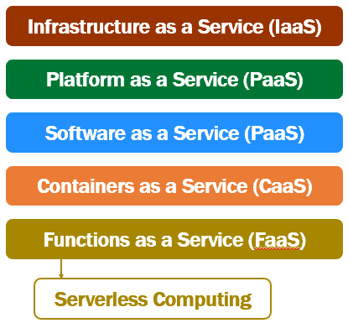

Slide 54
With cloud technologies advancing and maturing so fast, in addition to these 3 cloud offerings, we also have
Containers as a Service (CaaS)
Functions as a Services (FaaS or Serverless Computing)

Slide 55
On premise data center
If we are not using cloud, we manage everything on-premise. Basically our organisation is responsible for managing pretty much everything.
Procuring physical servers, storage and related hardware
Install and set up the network
Setting up the server room or data center
Make sure there is main power supply, back-up power supply, cooling system etc are in place
Install and configure virtualization software, operating system, any middleware or runtime components that your software developement or other teams need.
Install, configure, and manage your custom or packaged apps and data.
So the point is, with on-premise data center, our organisation is reponsible for managing pretty much everything.

Slide 56
What is Infrastructure as a Service (IaaS)
As the name implies, with Infrastructure as a Service, you rent or lease IT infrastructure from a cloud service provider like Microsoft Azure, Amazon Web Services or some other cloud provider. To understand this better, take a look at the following diagram.
infrastructure as a service explained

Slide 57
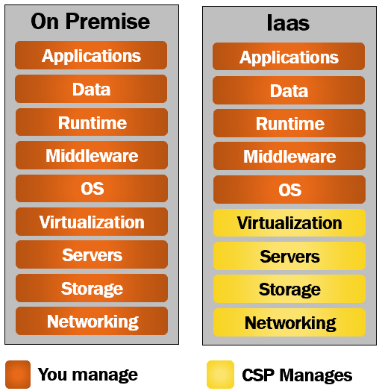

Slide 58
As the name implies, with Infrastructure as a Service, the cloud service provider provides the infrastructure over an internet connection or through a virtual private network. We will discuss what a virtual private network is in our upcoming articles. For now, you can think of it as a dedicated and secure private tunnel between you (i.e your organization) and the cloud service provider.
So the important point to keep in mind here is, there is no need for your organization to procure and manage the infrastructure. It is the cloud service provider that is responsible for
Procuring physical servers, storage and related hardware
Install and set up the network
Make sure there is proper power supply, back-up power supply, cooling system etc are in place
Pretty much the cloud service provider is responsible for setting up, securing and managing the cloud data center.
So in simple terms, this is how it works. The cloud service provider hosts the infrastructure at their data center. You as a customer, provision this infrastructure on-demand over the internet or through a virtual private connection. For the duration that you use the infrastructure, you pay a fee. You are only charged based on the number of machines and resources that are actually being used.
As you can see from the image, all the yellow boxes, i.e networking, storage, servers and virtualization are managed by the cloud service provider. The rest (i.e OS, Middleware, Runtime, Data and Application) are still managed by you.

Slide 59
This means you have better control and you can install any operating system of your choice, windows or linux for example. So the point is, you can use this infrastructure for anything you want. Computational or storage needs. May be, you have a web application which, you can host and run for example. You can also use it for your storage needs. For example, install SQL Server, Oracle or some other relational database and store your relational data. I mean, a diverse set of use cases are supported. Infrastructure as a service (IaaS) is also known as hardware as a service (HaaS).
Who uses Infrastructure as a Service (IaaS)
In most organisations, it is the Infrastructure team that procures servers, and computers. Install software and provide systems to employees. Set up and manage networks. So in most cases, it is usually your infrastructure team that uses Infrastructure as a Service (IaaS). Sometimes, even software developments teams use this service if they want to have enhanced control over the underlying hardware and network.
Benefits of Infrastructure as a Service (IaaS)

Slide 60
Reduced financial risk
There is a reduced financial risk for organisations. Let's say, for example, you want to try something new (may be you are launching a new business or product line or experimenting something entirely new) and for that you need a software application. To host and run this application you need a server, all the related infrastructure and workforce to setup and maintain. What if your new product launch or experiment fails. You have already spent a fortune to purchase the server and related infrastructure.
With the Infrastructure as a Service, you pay a fee, for as long as you use the cloud infrastructure. Host your app and run it from there. If your new product launch or experiment succeeds, well and good. If it doesn't shut things down and you pay no longer. Straight away, you can see how organisations can benefit from the reduced financial risk. This encourages businesses to try new things, experiment and innovate more.
Deployment Speed
Just imagine the time it takes to procure physical servers, storage and the related infrastructure. You need to purchase. Get them shipped over. Create a server room or data center. Secure it. Install power supply and cooling systems. Setup and configure network. The list goes on. You also need to hire skilled people to do all these. It takes a considerable amount of time to have all these in place. Probably days, sometimes even months in worst case scenarios.
On the other hand, if you are using, Infrastructure as a Service, you point your browser to the cloud service provider web portal, and with a few clicks in just a few minutes you have one or many virtual machines procured. So you can see the speed with which we can procure and start using cloud infrastructure. So you really get time to focus on what matters to your business.
Provision resources from geographically closer locations
Cloud service providers, for example, Amazon, Microsoft and Google, have data centers all over the world. This means, with the Infrastructure as a Service, you have the option of provisioning the servers from geographic locations close to your customers.

Slide 61
What is PaaS in cloud computing | Platform as a Service
In our previous article we understood what is Infrastructure as a Service. In this article we will understand, what is Platform as a Service (also called PaaS), who uses this service and the benefits it provide.
What is Platform as a Service (PaaS)
If you have read our previous article, what is Infrastructure as a Service then, understanding what is Platform as a Service is very easy. It boils down to what we (i.e our organisation) manages verus what the cloud service provider manages. With the, Infrastructure as a Service the cloud service provider manages the infrastructure (i.e Networking, Servers, Storage and Virtualization). We manage everything else (i.e the Operating System, Middleware, Runtime, Data and Application).

Slide 62
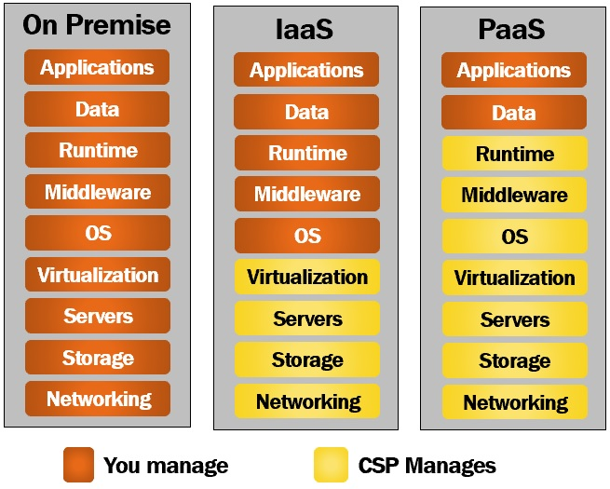

Slide 63
When compared with Infrastructure as a Service, Platform as a Service provides an even higher level of abstraction. You can think of it as a layer on top of Infrastructure as a Service. It shifts more responsibility to the cloud service provider. As you can see from the diagram, you manage just your business applications or services and the underlying data. The rest is managed by the cloud service provider. You don't have to worry about any of the things like, managing the network or underlying infrastructure. Installing the operating system updates, critical patches, runtime or middleware components. All these are taken care by the cloud service provider. This gives you, even more time to concentrate on what matters to your business.

Slide 64
Who uses Platform as a Service (IaaS)
Well, it is primarily used by software development teams. As the name implies, it provides the platform for developing software applications. It is a complete development and deployment environment in the cloud. It enables you to deliver everything from simple cloud-based apps to sophisticated, enterprise class cloud-enabled apps.
For example, let's say you want to develop data driven web applications. For this, we need a framework like ASP.NET Core or Java. To store data we need a database like SQL Server or Oracle for example. We need a web server to host and run a web application. Purchasing all these softwares, installing, setting up the development environment and maintaining it, is not only expensive but also time consuming.

Slide 65
ith Platform as a Service, the cloud service provider, provides all these softwares, installs and configures them. You have the development platform available with a few clicks in just a few minutes. You pay for the service on a pay-as-you-go basis and access it over a secure Internet connection. When you no longer need the service, you shut things down and stop paying.
Windows Azure, AWS Elastic Beanstalk, and Google App Engine are few examples of Platform as a Service.
Advantages of Platform as a Service
Platform as a service is a layer on top of Infrastructure as a Service. So it has all the benefits of IaaS plus the benefits specific to PaaS. IaaS provides many benefits like

Slide 66
Reduced financial risk
Deployment Speed
Provision resources from geographically closer locations
Auto scaling resources (i.e the underlying virtual infrastructure) up and down depending on demand
We discussed IaaS benefits in detail, in our previous article. The following are the benefits specific to platform as a service.
Greatly reduces development time
Platform as a Service greatly reduces development time. Just imagine the amount of time it takes to procure your own infrastructure, purchase all the softwares, install, configure and set up your own development environment. With Platform as a Service, in just a few minutes with a few simple clicks you gain instant access to a complete software development environment. It also provides templates and reusable application components and features such as search, directory services, security features and so on.
Great support for global teams
Platform as a Service, supports global teams. To access the development environment, all you need is an internet connection. So your development team members can be located anywhere in the world, I mean, in any remote location. It doesn't really matter. As long as they have an internet connection, they can connect and work together on projects.
Develop for multiple platforms
PaaS provides options for developing multiple platforms, such as computers, mobile devices and browsers. In short, it makes developing cross-platform apps quicker and easier.

Slide 67
What is SaaS in cloud computing | Software as a Service
In this article we will understand, what is Software as a Service (also called SaaS). Who uses this service. Few examples and the benefits it provides.
What is Software as a Service (SaaS)
In our previous 2 articles, we discussed
What is Infrastructure as a Service
What is Platform as a Service
As you can see from the diagram below, with Software as a Service, the cloud service provider manages everythig for us. We do not have to worry about any of the following
Purchasing and setting up physical hardware.
Installing operating system.
Virtualization.
Setting up network.
Installing and maintaining middleware, runtime and applications.

Slide 68
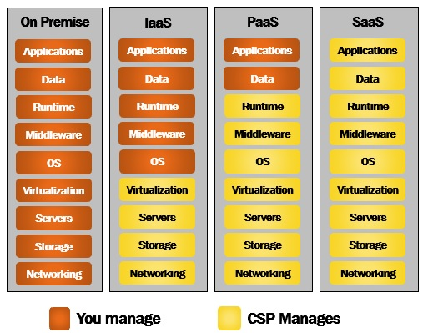

Slide 69
All these are taken care by the service provider. So the bottom line is, all the hardware and software is maintained for us by the cloud service provider. We simply access the software i.e the application which we want to use for our business over the internet. The software runs at the cloud service provider data center on their physical servers. Event the data the application captures is stored at the cloud service provider data center. So the point, that I am trying to make is, everything is managed for us by the cloud service provider. We simply access the service over the internet and as it supports pay as you go model, we pay a monthly fee based on the usage.

Slide 70
Who uses Software as a Service
Everyone, individuals and organisations of all sizes - small, medium and even large enterprises.

Slide 71
Examples of Software as a Service
I bet most of us will be using at least 2 to 3 Software as a Service applications. A few examples of Software as a Service are GMAIL, Netflix, Amazon Prime, Dropbox, Google Drive and Office 365. How many of these SaaS applications do you use. If you aske me, I use all ofthem. If we take GMAIL for example. It is hosted by Google on their physical servers at their data-centers. We don't host or install anything on our computer or laptop. We simply fire up our favourite browser, point it to GMAIL.com and access the GMAIL software as a service over the internet.
There are a wide variety of SaaS applications both for personal and business use cases. We have SaaS applications for customer relationship management (CRM), financial management, sales management, human resource management (HRM), billing, entertainment, storage, collaboration etc.

Slide 72
Benefits of Software as a Service
Very easy to get started
It is very easy to get started with a SaaS application. Think about a traditional business application running on-premise. You need to purchase hardware i.e a physical server and all the related hardware. Install the operating system, runtime, middleware and any other dependencies. On top of this you install the software application, configure it and then you have it available for business. You also need to recruit work-force to maintain the servers and the application i.e install patches and updates.
Compare this to a SaaS application. You simply fireup your favourite browser and access the SaaS application over the internet. There might be some customization and configuration required, but it is definitely very easy to get started with a SaaS application than running that same application on-premise.
Accessibility
You access SaaS applications over the internet. So this means as long as you have an internet connection, you can access a SaaS application from anywhere and any internet enabled device.
Automatic updates
With a SaaS application you don't have to worry about installing updates or patches. These are automatically provided by the cloud service provider, that too, in most cases, with a ZERO down-time. This obviously reduces the burden on the in-house development and IT staff.
Flexible usage-based pricing
Flexible usage-based pricing. No upfront huge capital expenditure. You only pay for what you use. For example, if you have 10 users using the application you only pay for that 10 users. You also have the flexibility to scale the number of users up and down depending on your business needs.

Slide 73
Reduced financial risk
With SaaS applications there is less financial risk. For example, if you want to see if a SaaS application adds value to your business, you can start with 1 or 2 users and see if it's really adding value. If it is, then you have the option to scale up the number of users. If it is not adding any value, you simply stop using the app and the payments. These days, most cloud service providers also offer free trials. You can try a SaaS app for free and see if it is adding any value. If it is not, there is no cost to your business anyway. Compare this to buying an expensive hardware and a packaged app upfornt. With SaaS applications, businesses definitely have reduced financial risks.
Affordability
Affordability is another great benefit. Applications and solutions that fall in the category of CRM (Customer Relationship Management) and ERP (Enterprise Resource Planning) for example are very expensive to buy out right. Especially for individuals, small and medium organisations, it's a huge burden. However, SaaS applications flexible pay-as-you-go model allows even small and medium organisations to trial and experiment if these expensive apps add value to their business. Basically it levels the playing field for everyone, including small businesses and individuals.

Slide 74
AZURE
Azure is a cloud computing platform from Microsoft. Initially it was called Windows Azure. Later renamed to Microsoft Azure. It is an ever expanding set of services to help you build solutions to meet your business goals. It offers a wide variety of services. For example, we have
Virtual machines running in the cloud for you to host and run your software.
Storage services to store all sorts of data - relational, non-relational etc.
Software development and deployment services.
Networking and Data analysis services.
Artificial Intelligence, Machine learning, Internet of Things etc. The list goes on.
When we think about moving to a cloud from an on-permise datacenter, 2 immediate things that come to our mind are security and availability.

Slide 75
Azure supports open source technologies
Many people think Azure is only for Windows apps and services. That's not true. Azure supports open source technologies, so you can use the tools and technologies you prefer. As of this recording, 1 in 4 Azure virtual machines run Linux. Why? Because Azure supports the open-source technologies millions of us already rely on and trust. With Azure, we have choices. We can develop, deploy and test open-source components end-to-end in Azure. As an example, Azure offers Enterprise-grade support for all popular Linux distributions. Run new and even existing business-critical workloads in the cloud with Azure Marketplace.
Almost anything that can be done with a conventional on-premise data center can be accomplished using Azure. Actually it opens a world of possibilities and help us build solutions that we wouldn't be able to build with our own on-premise datacenter. Azure has series of data centers across the globe. So we are able to take advantage of that global reach, massive scale and build solutions that otherwise are practically impossible.

Slide 76
What are Azure Data Centers
To understand Azure better, we need to understand Azure global infrastrcuture specific terms like
Datacenters
Regions
Region Pairs
Availability Zones and
Geographies

Slide 77
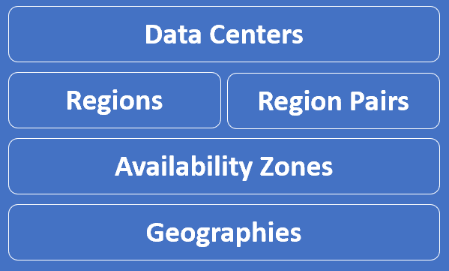

Slide 78
What are Azure Data Centers
When we provision a resource from Azure cloud, like a Virtual Machine or an Azure SQL Database for example.

Slide 79
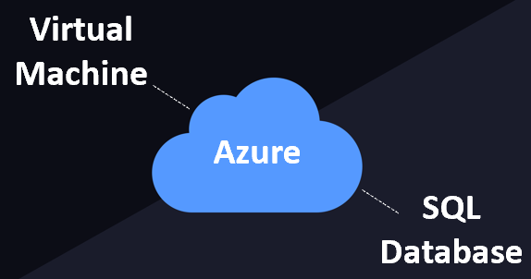

Slide 80
These resources obviously require a physical server space to be created. A datacenter is simply a building that contains the physical server. Not just one server, many many physical servers which are connected over a network. It also has it's own power, and cooling.

Slide 81
So, in simple terms, an Azure data center is a unique physical building that contains many many physical servers with it's own power, cooling and networking infrastructure. These data ceneters are located all over the globe. As of this course recording, there are over 160+ Azure datacenters worldwide. The exact location of these datacenters is not published by Microsoft for obvious security reasons. It is these dataceneters that are the building blocks of gloabl Azure infrastructure.

Slide 82
Azure Geographies
This is Part 3 of Azure tutorial. In our previous article we discussed Azure Datacenters. In this article we will discuss Azure Geographies.
Azure Geographies
An Azure geography is an area of the world that contains at least one Azure region. For example, India is a geography. Similarly United States and United Kingdom are geographies.
As of this writing, the following are the Azure geographies available. Azure is growing at a very rapid pace, so by the time you watch this course there might be a lot more geographies available.
India
United States
United Kingdom
Canada
Africa
Australia
Europe
Asia Pacific
Azure Government
Austria
Brazil
China
France
Germany
Greece
Israel
Italy
Japan
Korea
Mexico
New Zealand
Norway
Poland
Qatar
Spain
Switzerland
Taiwan
United Arab Emirates

Slide 83
Azure resource groups
This is Part 5 of Azure Tutorial. In this article we will understand Azure Resources and Resource Groups.
azure resource groups explained
What are Azure Resources

Slide 84
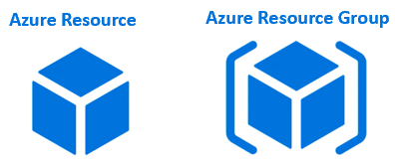

Slide 85
Resources are instances of azure services that you create, like virtual machines, app services, storage accounts, SQL databases, function apps etc. All these are azure services. Everytime you create an instance of a service, you are creating a resource. There are hundereds of azure services.

Slide 86
What is an Azure Resource Group
As the name implies, a Resource Group is a group of azure resources like virtual machines, app services, storage accounts, SQL databases etc. It's a logical container for grouping related azure resources.
Azure Resource Group Example
Let's say we are developing a web application. There are several ways to do this. To keep this example simple, let's just assume we need the following 3 azure resources.
Virtual Machine - To host and run our web application
Storage Account - To store images, videos and other resources that our web application needs
SQL database - To store our application data
Let's say for this example sake we have the following environments. Most organisations have these deployment environments.
Development
Testing
Staging
PreProduction
Production
Let's say our web application name is PragimTech.com. We might create the following 4 resource groups, one for each environment.
rg-pragimtech-development
rg-pragimtech-staging
rg-pragimtech-preproduction
rg-pragimtech-production

Slide 87
Grouping by deployment environment is just one way of grouping. Obviously you can group resources any way you want. Anyway that makes sense to your oragnisation really.
By department,
By country,
By application,
By resource type or a
Combination of these
In general, resources that share the same deployment lifecycle are grouped, so these resources can be easily provisioned i.e created, deployed, updated, and deleted as a single unit. There are several benefits of grouping resources. We will discuss the benefits of resource groups in our next article.

Slide 88
Azure resource group benefits
This is Part 6 of Azure tutorial. In our previous article we discussed Azure Resource Groups. In this article, we will discuss the benefits of Azure Resource Groups. Before we discuss the benefits, let's quickly recap the main and important points of azure resource groups.
Azure resource groups - Imporantant points to remember
An azure resource is any service instance that you create. For example, virtual machine, Azure sql database, storage account etc.
A resource group, as the name implies, a group of related azure resources.
In general, resources in a resource group share the same life cycle, so they can be easily created, deployed, updated, and deleted as a single unit.
When you create a resource group, you specify a region. It is this region where the meta-data about the resource group is stored.
However, the resources themselves can be in any azure region.
Resources in one resource group can interact with resources in other resource groups.
Each resource must be in one and only one resource group. You cannot have a resource in more than 1 resource group at the sametime.
You can move a resource from one resource group to another.
You can add or remove a resource from a resource group at any time.
You can group resources any way you want. Anyway that makes sense to your oragnisation really - By department, By country, By application, By resource type or a combination of these.

Slide 89
Benefits of Azure Resource Groups
Administration is much easier
Let's understand this with an example. Consider a virtual machine.
azure virtual machine dependencies
When we create a virtual machine in azure several other associated resources like the following are created.
a data disk for the virtual machine
Public IP address
Network interface
Network security group
Virtual network

Slide 90
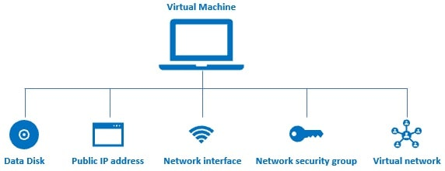

Slide 91
Without these resources, an azure virtual machine doesn't work as expected. After you are done with the VM, you may want to delete it to save on cost. However, when you delete the VM the associated resources are not automatically deleted. You have to delete them manually. If you forget to delete 1 or more associated resources, you are unnecessarily paying for those resources that you are not actually using.
On the other hand, if you create a virtual machine in a resource group, all the other associated resources are also created in the same resource group. When we delete the resource group, not just the virtual machine, all it's associated resources are also automatically deleted.

